Slide 1

Module 2
Data Types, Variables, and Constants

Slide 2
Learning Objectives
Describe the relationship between the number of bits we use and the number of things we can represent with those bits.
Describe the two things a data type tells us
Assign values to variables and change their values through mathematical operators to solve specific problems
Prompt for and get user numeric input required for specific calculations
Develop a console application to meet specific functional requirements.

Slide 3
Content (Slot 1)
Variables
Value Types, Variables, and Constants
Integers
Exercise 3
Exercise 4
Floating Point Numbers
Exercise 5
Exercise 6
Exercise 7

Slide 4
Content (Slot 2)
Decimals/ Characters/ Booleans
Operations
Choosing Between Variables and Constants
Giving Variables a Value
Type Conversions
What About Reference Types?
Putting It All Together in a Console App
Putting It All Together in a Unity Script
Common Mistakes

Slide 5
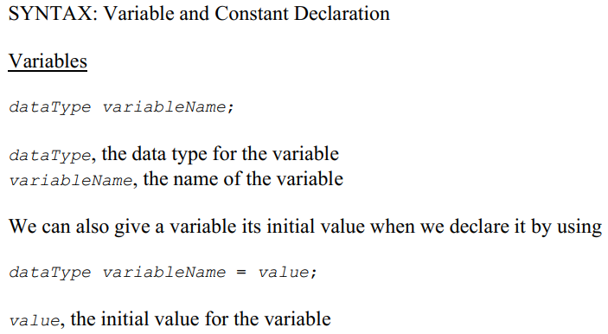
Variables
To store something (such as a name, the value of Pi, or a GameObject) in our program, we need to declare a variable or a constant.

Slide 6
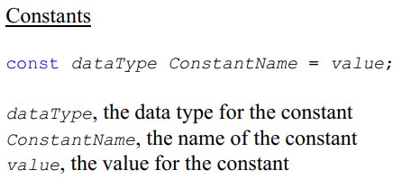
Variables
For variable names, we use something called Camel case, eg. variableName.
For constant names, we use something called Pascal case, eg. ConstantName.

Slide 7
Variables
Data in C# fall into two categories: value types and reference types.
A variable of a value type contains an instance of the type.
On assignment, the corresponding type instances are copied.
A variable of a reference type contains a reference to an instance of the type.
On assignment, only the reference to the instance of the reference type is copied.

Slide 8
Value Types, Variables, and Constants
Value types are the most basic data types there are in C#, and their values are stored directly into memory locations.
For a variable, the contents of the location are called the value of the variable – and we can change what's in that location as many times as we want as the program executes.
For a constant, the memory location contains whatever we said the constant's value would be, and we're never allowed to change it as the program executes.
Rules for declaring a variable/ a constant are in the previous module.

Slide 9

Value Types, Variables, and Constants
The data type for a variable or constant tells us two things:
What values the variable or constant can have, and
What operations are valid for the variable or constant
Example:
tells us that the only values this variable can have are floating point numbers and also know which operations (+, -, *, / etc.) are valid for this variable

Slide 10

Integers
We might use an integer variable to
Count things
Store the number of points a student gets on a test
Keep track of the current pixel location of a game object
Indicate the amount of damage a particular weapon inflicts
etc.
Example declarations:

Slide 11
Integers
The valid operations for integers: +, -, *, /, %, ++, --
Four different data types: byte, short, int, and long
What is size of each integer type?
What are minimum and maximum value of them?
Why do people care about these?

Slide 12
Exercise 3: Declaring and Using Variables
Problem – Declaring and using variables
Create a new C# Console Application named Exercise3.
In the Main method, do the following:
Declare a variable named age of type int
Store your age in this variable.
Print the value of the variable to the user.

Slide 13
Exercise 4: Calculating with Integers
Problem – Calculating with integers
Create a new C# Console Application named Exercise4.
In the Main method, do the following:
Prompt for and get the altitude for a location as an int.
Prompt for and get the altitude for a second location as an int.
Calculate and display the altitude change you'd experience moving from the first point to the second point.
Hint: The order of the subtraction matters, so make sure you're getting the correct sign on your answer.

Slide 14
Floating Point Numbers
How to store and process numbers that have a decimal part as well as a whole number part, e.g. -3.7, 0.00001, 5.0, and 483.256?
Two different data types for floating point numbers: float and double
A float variable or constant gets 32 bits of memory, and a double variable or constant gets 64 bits.
Unity tends to favor float over double.
The valid operations for floating point: +, -, *, and /
How to store a floating point?
Mantissa and exponent

Slide 15
Exercise 5: Declaring and Using Variables and Constants
Problem – Declaring and Using Constants and Variables
Create a new 2D Unity project named Exercise5. Add a scenes folder and save the current scene as scene0. Add a scripts folder and add a new C# script named PrintPercent.
Open the script, fill in the comment near the top of the script, and delete the Update method. Add the following code to the Start method:
Declare a constant named MaxScore of type int and assign it a value of 100.
Declare a variable named score of type int and assign it a value between 0 and 100.
Declare a variable named percent of type float and store the percent calculated by dividing score by MaxScore. Remember how integer division works in C# and use type casting as appropriate.
Print the percent in the Unity Console window. The percent you print should be between 0% and 100%.
Attach the script to the Main Camera in the scene and run the game to see the output in the Console window.

Slide 16
Exercise 6: Trigonometry with Floats
Problem – Trigonometry with floats
Create a new C# Console Application named Exercise6.
In the Main method, do the following:
Prompt for and get an angle in degrees and store it in a float variable.
Calculate and display the cosine and sine of the angle.
Hint 1: The Math class is very useful for this, so you should look at the documentation for that class; you can find that documentation at https://msdn.microsoft.com/en-us/library/system.math(v=vs.110).aspx
Hint 2: As you read the documentation for the methods that calculate cosine and sine, you'll discover that they expect you to provide an angle in radians, not degrees. To convert the angle from degrees to radians, you can simply multiply the angle by (float)Math.PI/180. Because Math.PI is a double, we need a type cast for this conversion.

Slide 17


Exercise 7: Calculations and Rounding
In this exercise, you'll be converting temperatures from Fahrenheit to Celsius and back again.
To convert from Fahrenheit to Celsius:
To go convert Celsius to Fahrenheit:

Slide 18
Exercise 7: Calculations and Rounding
Problem 1 – Temperature Calculations with Int
Create a new 2D Unity project named Exercise7. Add a scenes folder and save the current scene as scene0. Add a scripts folder and add a new C# script named ConvertTemperatures.
Open the script, fill in the comment near the top of the script, and delete the Update method. Add the following code to the Start method:
Declare three int variables to store an original temperature in Fahrenheit, a calculated temperature in Celsius, and a calculated temperature in Fahrenheit (when you convert from Celsius back to Fahrenheit).
Assign 0 as your original temperature in Fahrenheit and print that Fahrenheit value, convert to Celsius and print the Celsius value, then convert the Celsius value back to Fahrenheit and print the Fahrenheit value. Be sure to label each of your outputs rather than just printing out the numbers.
Assign 32 as your original temperature in Fahrenheit and print that Fahrenheit value, convert to Celsius and print the Celsius value, then convert the Celsius value back to Fahrenheit and print the Fahrenheit value. Be sure to label each of your outputs rather than just printing out the numbers.
Assign 212 as your original temperature in Fahrenheit and print that Fahrenheit value, convert to Celsius and print the Celsius value, then convert the Celsius value back to Fahrenheit and print the Fahrenheit value. Be sure to label each of your outputs rather than just printing out the numbers.
Attach the script to the Main Camera in the scene and run the game to see the output in the Console window.

Slide 19
Exercise 7: Calculations and Rounding
Problem 2 – Temperature Calculations with Float
Add the following code to the Start method after the code you already added:
Declare three float variables to store an original temperature in Fahrenheit, a calculated temperature in Celsius, and a calculated temperature in Fahrenheit (when you convert from Celsius back to Fahrenheit).
Assign 0 as your original temperature in Fahrenheit and print that Fahrenheit value, convert to Celsius and print the Celsius value, then convert the Celsius value back to Fahrenheit and print the Fahrenheit value. Be sure to label each of your outputs rather than just printing out the numbers.
Now the conversion from 0 to Celsius and back to Fahrenheit is closer to 0, but it’s still not exactly 0. Remember, even though floating point numbers are approximations of the real numbers in the continuous domain, they give us more precision than whole numbers do. That's why we got a closer final Fahrenheit temperature when we used float variables instead of int variables.

Slide 20
Exercise 7: Calculations and Rounding
Problem 3 – Temperature Calculations with Double
Add the following code to the Start method after the code you already added:
Declare three double variables to store an original temperature in Fahrenheit, a calculated temperature in Celsius, and a calculated temperature in Fahrenheit (when you convert from Celsius back to Fahrenheit).
Assign 0 as your original temperature in Fahrenheit and print that Fahrenheit value, convert to Celsius and print the Celsius value, then convert the Celsius value back to Fahrenheit and print the Fahrenheit value. Be sure to label each of your outputs rather than just printing out the numbers.
Finally, the conversion from 0 to Celsius and back to Fahrenheit yields a 0 as you probably originally expected. Because the double data type uses more bytes than the float data type, we don’t get the rounding error we got when we used floats.

